Slide 1
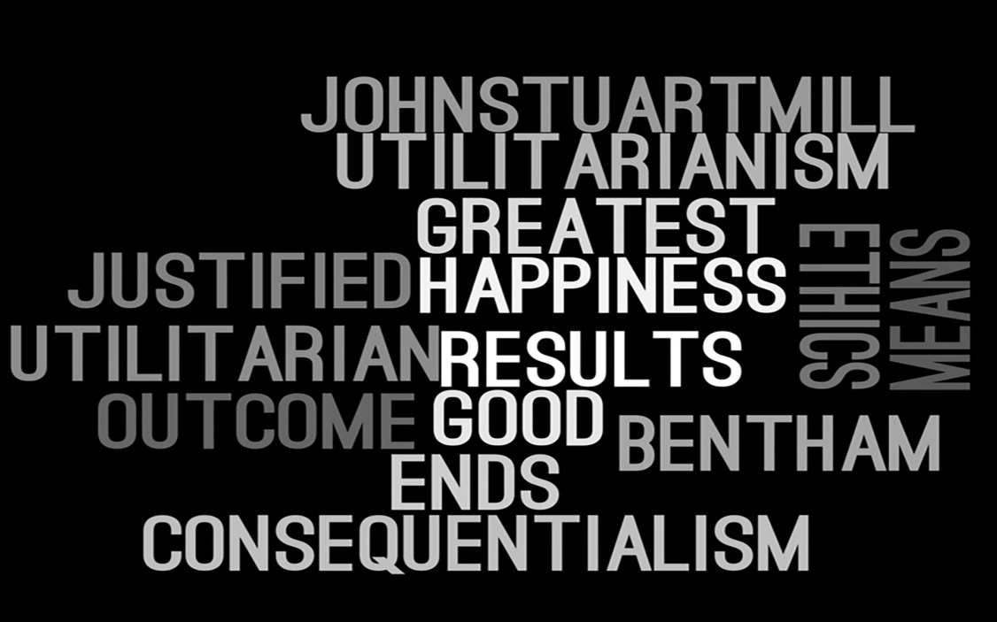
WHAT IS UTILITARIANISM?

Slide 2
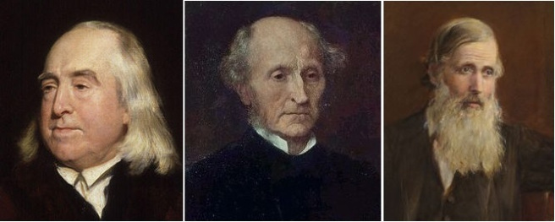
Who developed utilitarianism
Utilitarianism was founded by Jeremy Bentham and further developed by his disciple, John Stuart Mill. Bentham was most interested in the ramifications that a utilitarian ethics would have for the law, , Mill suggested that some happiness was of such a high quality that any amount of it would be preferable to any amount of a happiness which was of a lesser quality.
Another 19th Century Philosopher, Henry Sidgwick, re-interpreted utilitarianism along lines which are more commonly used today. He found that the classification of utility as happiness was clumsy and so began to talk about utility as a measure of desire and satisfaction.

Slide 3
what are the main principles of utilitarianism?
Pleasure or happiness is the only thing that truly has an intrinsic value.
Actions are right so far as they promote happiness,wrong as so far as they produce unhappiness.
Everyone’s happiness counts equally.

Slide 4
three characteristics of utilitarianism
Pleasure or Happiness Is the Only Thing That Truly Has Intrinsic Value.
2. Actions Are Right Insofar as They Promote Happiness, Wrong Insofar as They Produce Unhappiness.
3. Everyone's Happiness Counts Equally.

Slide 5

What is the goal of utilitarianism?

Slide 6
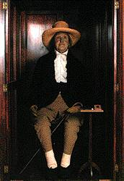
Bentham’s theory of utility
(1)Recognizes the fundamental role of pain and pleasure in human life
(2) approves or disapproves of an action on the basis of the amount of pain or pleasure brought about i.e, consequences
(3) equates good with pleasure and evil with pain
(4) asserts that pleasure and pain are capable of quantification (and hence 'measure').

Slide 7
What are the types of utilitarianism?
Negative utilitarianism
Sentient utilitarianism
Average utilitarianism
Total utilitarianism
Motive utilitarianism
Rule utilitarianism
Act utilitarianism
Two-level utilitarianism

Slide 8
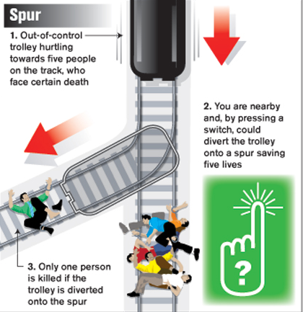
examples
Imagine there is a trolley heading toward a group of 5 workers on the tracks. You are sitting in a control center several miles away, and you have a button that can switch the trolley onto another track where there’s only 1 worker. If you flip the switch, one person will die. If you do nothing, 5 people will die. Should you flip the switch?

Slide 9

Advantages and disadvantages of utilitarianism

Slide 10
Why it is a good ethical theory
Utilitarianism is an ethical theory that determines right from wrong by focusing on outcomes
Utilitarianism is one of the best known and most influential moral theories.

